Slide 1
Recursion

Slide 2
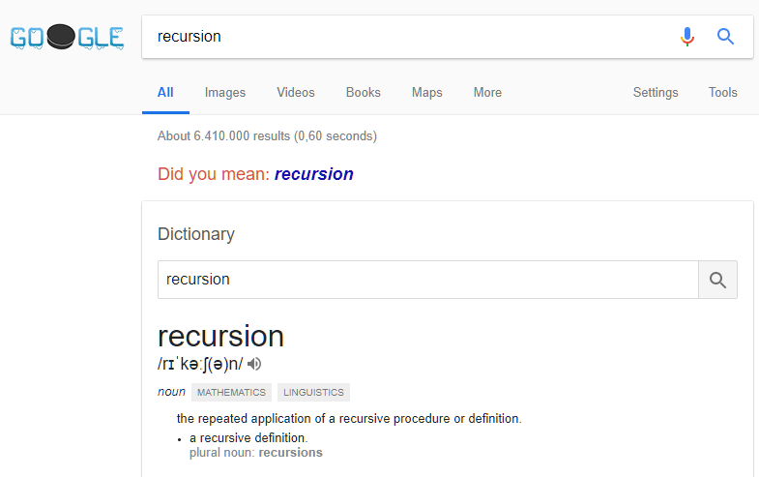

Slide 3
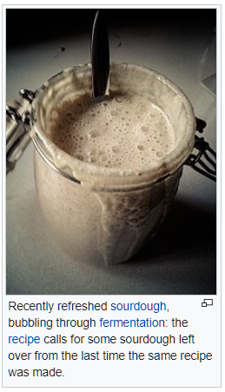

Slide 4

public void PrintHello()
{
Console.WriteLine("Hello");
PrintHello();
}

Slide 5
public void PrintHello(int callsLeft)
{
if (callsLeft > 0)
{
Console.WriteLine("Hello");
PrintHello(callsLeft - 1);
}
}

Slide 6
Parts of a Recursive definition
A trivial case: a case for which we have a simple solution, that does not require any calculation.
A division strategy: a way of splitting the problem into smaller parts, which can themselves be solved trivially or by recursion
A combination strategy: a way of combining the solutions for the simpler pro­blems into a solution for the original problem

Slide 7
Factorial
Factorial(n) = n x (n – 1) x (n – 2) x … x 2 x 1
Factorial(5) = 5 x 4 x 3 x 2 x 1 = 120
Factorial(1) = 1
Factorial(n) = n x Factorial(n – 1)

Slide 8
Parts of a Recursive definition (Factorial)
A trivial case: Factorial(1) = 1.
A division strategy: Split Factorial(n) into n (trivial) and Factorial(n - 1), which can be solved by recursion
A combination strategy: Multiply n and Factorial(n - 1).

Slide 9
public int Factorial(int n)
{
return (n <= 1) ?
1 :
(n * Factorial(n – 1));
}

Slide 10
public int Factorial(int n)
{
return (n <= 1) ? 1 : (n * Factorial(n – 1));
}

Slide 11
public int Factorial(4)
{
return (4 <= 1) ? 1 : (4 * Factorial(4 – 1));
}

Slide 12
public int Factorial(4)
{
return (4 <= 1) ? 1 : (4 * Factorial(3));
}

Slide 13
public int Factorial(4)
{
return (4 <= 1) ? 1 : (4 * (return (3 <= 1) ? 1 : (3 * Factorial(3 – 1))));
}

Slide 14
public int Factorial(4)
{
return (4 <= 1) ? 1 : (4 * (return (3 <= 1) ? 1 : (3 * Factorial(2))));
}

Slide 15
public int Factorial(4)
{
return (4 <= 1) ? 1 : (4 * (return (3 <= 1) ? 1 : (3 * return (2 <= 1) ? 1 : (2 * Factorial(1)))));
}

Slide 16
public int Factorial(4)
{
return (4 <= 1) ? 1 : (4 * (return (3 <= 1) ? 1 : (3 * return (2 <= 1) ? 1 : (2 * 1))));
}

Slide 17
public int Factorial(4)
{
return (4 <= 1) ? 1 : (4 * (return (3 <= 1) ? 1 : (3 * return (2 <= 1) ? 1 : 2)));
}

Slide 18
public int Factorial(4)
{
return (4 <= 1) ? 1 : (4 * (return (3 <= 1) ? 1 : (3 * 2)));
}

Slide 19
public int Factorial(4)
{
return (4 <= 1) ? 1 : (4 * (return (3 <= 1) ? 1 : 6));
}

Slide 20
public int Factorial(4)
{
return (4 <= 1) ? 1 : (4 * 6));
}

Slide 21
public int Factorial(4)
{
return (4 <= 1) ? 1 : 24);
}

Slide 22
public int Factorial(4)
{
return 24;
}

Slide 23
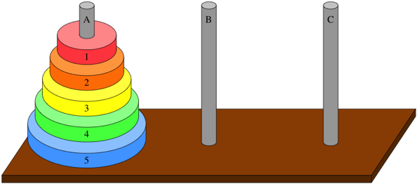

Slide 24
Parts of a Recursive definition (Towers of Hanoi)
A trivial case: n = 0, no disks to move.
A division strategy:
Move (n – 1) disks from A to B
Move disk n from A to C
Move (n – 1) disks from B from C
A combination strategy: The three steps in combination solves the original problem for n disks.

Slide 25
public void TowersOfHanoi(string source, string extra, string target, int n)
{
if (n > 0)
{
TowersOfHanoi(source, target, extra, n - 1);
Console.WriteLine ($"Move disk {n}: {source}->{target}");
TowersOfHanoi(extra, source, target, n - 1);
}
}

Slide 26
Fibonacci
Fibonacci(1) = 1
Fibonacci(2) = 1
Fibonacci(n) = Fibonacci(n – 1) + Fibonacci(n – 2)

Slide 27
public int Fibonacci(int n)
{
return (n < 3) ?
1 :
Fibonacci(n – 1) + Fibonacci(n - 2);
}

Slide 28
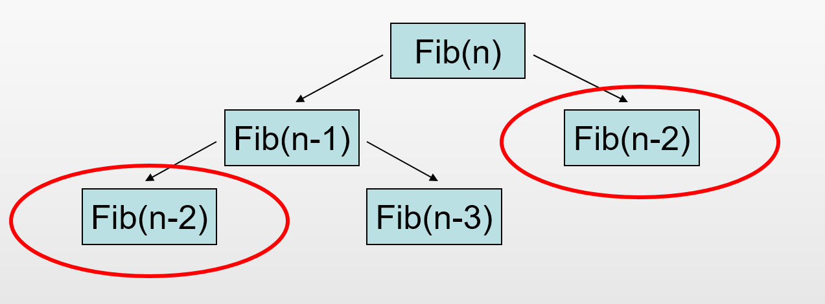

Slide 29
Recursion usefulness
More efficient
Harder to code
Easier to code
Faculty
ToH
Fibonacci
Less efficient

Slide 30

Recursion summary
Not a silver bullet!
Useful if problem has a natural recursive formulation, and/or non-recursive formulation is much more complex
Beware of efficiency

